Slide 1
Mobile Design - Android

Slide 2
Outline
Android – background, architecture and features
Android Studio basics
Basic concepts – Resources, Activity, Services, etc.
Event handling
HTTP networking and JSON parser
Running application on an Android device/Emulator
References

Slide 3
Background
Android is an open source and Linux-based Operating System for smartphones.
Android Inc. was founded in Palo Alto, California in October 2003 by Andy Rubin, Rich Miner, Nick Sears, and Chris White.
Android was pitched as a handset operating system that would rival Symbian and Microsoft Windows Mobile.
In July 2005,Google acquired Android Inc. for at least $50 million. Its key employees, including Rubin, Miner and White, joined Google as part of the acquisition
On November 5, 2007, the Open Handset Alliance, a consortium of technology companies including Google, device manufacturers such as HTC, Motorola and Samsung, wireless carriers such as Sprint and T-Mobile, and chipset makers such as Qualcomm and Texas Instruments, unveiled itself, with a goal to develop "the first truly open and comprehensive platform for mobile devices".
Developers need to develop only once for Android and the applications run across all Android devices.
The first beta version of the Android Software Development Kit (SDK) was released by Google in 2007 where as the first commercial version, Android 1.0, was released in September 2008.
The first commercially available smartphone running Android was the HTC Dream, also known as T-Mobile G1, announced on September 23, 2008.

Slide 4
Features
Open Source
Larger Developer Community
High Marketing
Rich Development Environment
Inter App Integration Feature
High Security
Reduced Cost of Development
Higher Success Ratio

Slide 5
Categories of Applications
Music
News
Multimedia
Sports
Lifestyle
Food & Drinks
Books
Weather
Reference
Navigation
Social Media

Slide 6
History
Android Version | Code name | API level
1.0 | APPLE PIE | 1
1.1 | BANANA BREAD | 2
1.5 | CUPCAKE | 3
1.6 | DONUT | 4
2.0, 2.1 | ECLAIR | 5, 6, 7
2.2 | FROYO | 8
2.3 | GINGERBREAD | 9 and 10
3.0, 3.1, 3.2 | HONEYCOMB | 12 and 13
4.0 | ICE CREAM SANDWICH | 14, 15
4.1, 4.2, 4.3 | JELLY BEAN | 16, 17 and 18
4.4 | KITKAT | 19, 20
5.0, 5.1 | LOLLIPOP | 21, 22
6.0 | MARSHMALLOW | 23
7.0, 7.1 | NOUGAT | 24, 25
8.0, 8.1 | OREO | 26, 27
Notes:
Some of the features of each version:
1.0: Download and updates via Android Market, Web Browser, Camera support, Gmail, Contacts and Google Agenda synchronization, Google Maps, YouTube application.
1.1: Ability to save MMS attachments, "Show" & "Hide" numeric keyboard, in caller application
1.5: Bluetooth A2DP and AVRCP support, Soft-keyboard with text-prediction, Record/watch videos
1.6: Gesture framework, Turn-by-turn navigation
2.0, 2.1: HTML, Digital zoom, Microsoft Exchange support, Bluetooth 2.1, Live Wallpapers, Updated UI
2.2: Speed improvements, JIT implementation, USB Tethering, Applications installation to the expandable memory, Upload file support in the browser, Animated GIFs
2.3: Updated UI, Improved keyboard ease of use, Improved copy/paste, Improved power management, Social networking features, Near Field Communication support, Native VoIP/SIP support, Video call support, Google Wallet support for the Nexus S 4G
3.0, 3.1, 3.2: Multi core support, Better tablet support, Updated 3D UI, System-wide Clipboard, HTTP Live streaming
4.0: New lock screen actions, Improved text input and spell-checking, Control over network data, Email app supports EAS v14, WI-FI direct, BlueTooth Health Device Profile
4.1, 4.2, 4.3: Google Now, Voice Search, Speed enhancements, Camera app improvements, Accessibility
4.4: Screen recording, New Translucent system UI, Enhanced notification access, System-wide settings for closed captioning, Performance improvements
5.0, 5.1: New design (Material design), Speed improvement, Battery consumption improvement, Multiple SIM cards support, High Definition voice call
6.0: USB Type-C support, Fingerprint Authentication support, Better battery life with "deep sleep”, Permissions dashboard, Android Pay, MIDI support, Google Now improvements
7.0, 7.1: Unicode 9.0 emoji, Better multitasking, Multi-window mode (PIP, Freeform window), Seamless system updates (with dual system partition), Better performance and code size thanks to new JIT Compiler, Daydream Virtual Reality mode, Night Light
8.0: Picture-in-Picture with resizable windows, Android Instant apps, Improved notifications system, Improved system settings, Lock screen redesign

Slide 7
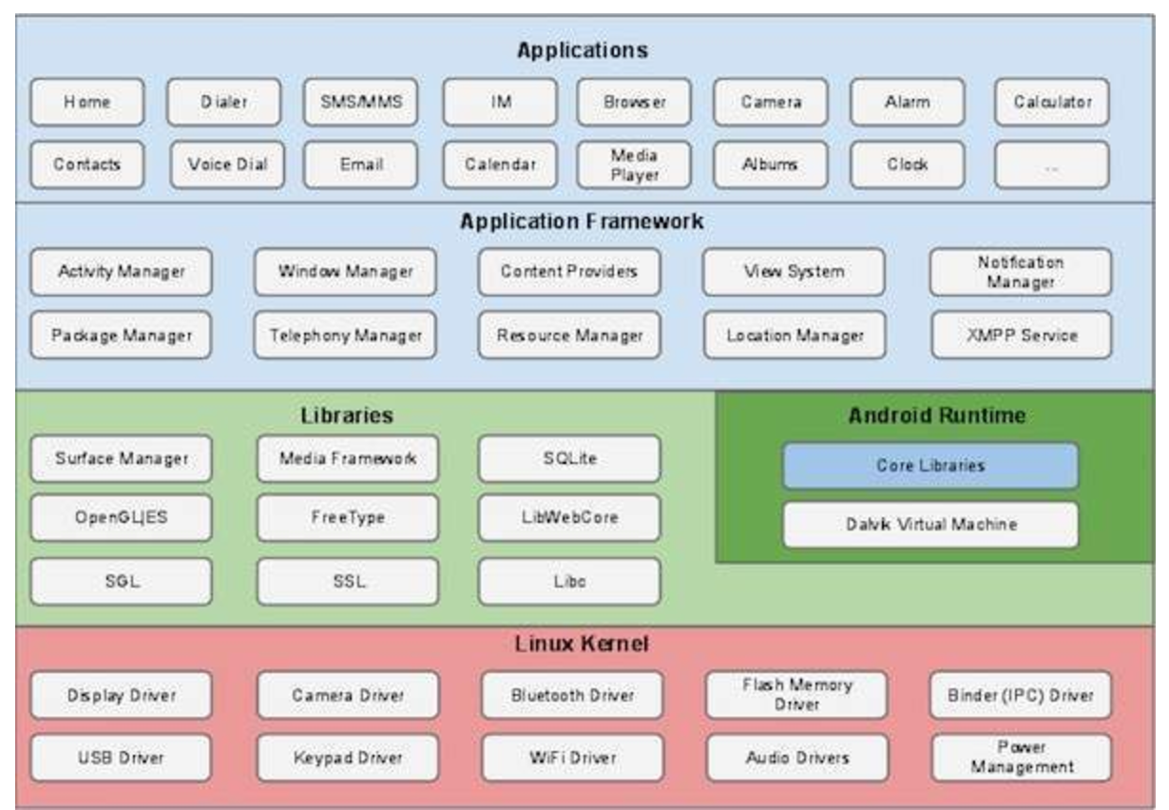
Architecture
Android operating system is a stack of software components which is roughly divided into five sections and four main layers as shown below in the architecture diagram.
Notes:
Bottom to top:
Lowest layer: Linux Kernel
Second layer: Libraries
Third layer: Android Runtime core libraries, Dalvik Virtual Machine
Fourth layer: Application Framework
Fifth Layer: is where you develop Applications

Slide 8
Architecture
Linux Kernel
Linux Kernel
Hardware drivers
Hardware/software interface
Application Framework
Runtime
Libraries
Linux Kernel
Notes:
At the bottom of the layers is Linux.
This provides a level of abstraction between the device hardware and it contains all the essential hardware drivers like camera, keypad, display etc.
Also, the kernel handles all the things that Linux is really good at such as networking and a vast array of device drivers, which take the pain out of interfacing to peripheral hardware.

Slide 9
Architecture
Libraries
android.app
android.content
android.database
android.opengl
android.os
Application Framework
android.text
android.view
android.widget
android.webkit
Runtime
Libraries
Linux Kernel
Notes:
On top of Linux kernel there is a set of libraries including open-source Web browser engine WebKit, well known library libc, SQLite database which is a useful repository for storage and sharing of application data, libraries to play and record audio and video, SSL libraries responsible for Internet security etc.
android.app − Provides access to the application model and is the cornerstone of all Android applications.
android.content − Facilitates content access, publishing and messaging between applications and application components.
android.database − Used to access data published by content providers and includes SQLite database management classes.
android.opengl − A Java interface to the OpenGL ES 3D graphics rendering API.
android.os − Provides applications with access to standard operating system services including messages, system services and inter-process communication.
android.text − Used to render and manipulate text on a device display.
android.view − The fundamental building blocks of application user interfaces.
android.widget − A rich collection of pre-built user interface components such as buttons, labels, list views, layout managers, radio buttons etc.
android.webkit − A set of classes intended to allow web-browsing capabilities to be built into applications.

Slide 10
Architecture
Runtime
Dalvik Virtual Machine
Core libraries
Application Framework
Runtime
Libraries
Linux Kernel
Notes:
Dalvik Virtual Machine is a kind of Java Virtual Machine specially designed and optimized for Andr The Dalvik VM makes use of Linux core features like memory management and multi-threading, which is intrinsic in the Java language. The Dalvik VM enables every Android application to run in its own process, with its own instance of the Dalvik virtual machine.
Core Libraries enable Android application developers to write Android applications using standard Java programming language.

Slide 11
Architecture
Application Framework
Activity Manager
Content Providers
Resource Manager
Notifications Manager
View System
Application Framework
Runtime
Libraries
Linux Kernel
Notes:
The Application Framework layer provides many higher-level services to applications in the form of Java classes. Application developers are allowed to make use of these services in their applications.
Activity Manager − Controls all aspects of the application lifecycle and activity stack.
Content Providers − Allows applications to publish and share data with other applications.
Resource Manager − Provides access to non-code embedded resources such as strings, color settings and user interface layouts.
Notifications Manager − Allows applications to display alerts and notifications to the user.
View System − An extensible set of views used to create application user interfaces.
You will find all the Android application at the top layer. You will write your application to be installed on this layer only. Examples of such applications are Contacts Books, Browser, Games etc.

Slide 12
Android Studio Basics
Setup
Create a new project
Get familiar with Android Studio
Design UI in XML using drag and drop in xml resource layout editor
Control UI using Activity
Change Activity properties in Manifest file
Run your app in the emulator

Slide 13
Setup
You can start Android application development on either of the following operating systems −
Microsoft Windows
Mac OS X
Linux
Following is the list of software's you will need before you start your Android application programming:
Java JDK5 or later version
Android Studio

Slide 14
Setup
You can download the latest version of Java JDK from Oracle's Java site − Java SE Downloads
Install and configure the setup.
Finally set PATH and JAVA_HOME environment variables to refer to the directory that contains java and javac, typically java_install_dir/bin and java_install_dir respectively.
If you are running Windows and installed the JDK in C:\jdk1.8.0_102, you would have to put the following line in your C:\autoexec.bat file.
set PATH=C:\jdk1.8.0_102\bin;%PATH%
set JAVA_HOME=C:\jdk1.8.0_102
Notes:
Java path needs to be set in OSX and Windows.

Slide 15
Setup
Alternatively, you could also right-click on My Computer, select Properties, then Advanced, then Environment Variables. Then, you would update the PATH value and press the OK button.
On Linux, if the SDK is installed in /usr/local/jdk1.8.0_102 and you use the C shell, you would put the following code into your .cshrc file.
setenv PATH /usr/local/jdk1.8.0_102/bin:$PATH
setenv JAVA_HOME /usr/local/jdk1.8.0_102
Alternatively, if you use Android Studio, then it will know automatically where you have installed your Java.

Slide 16
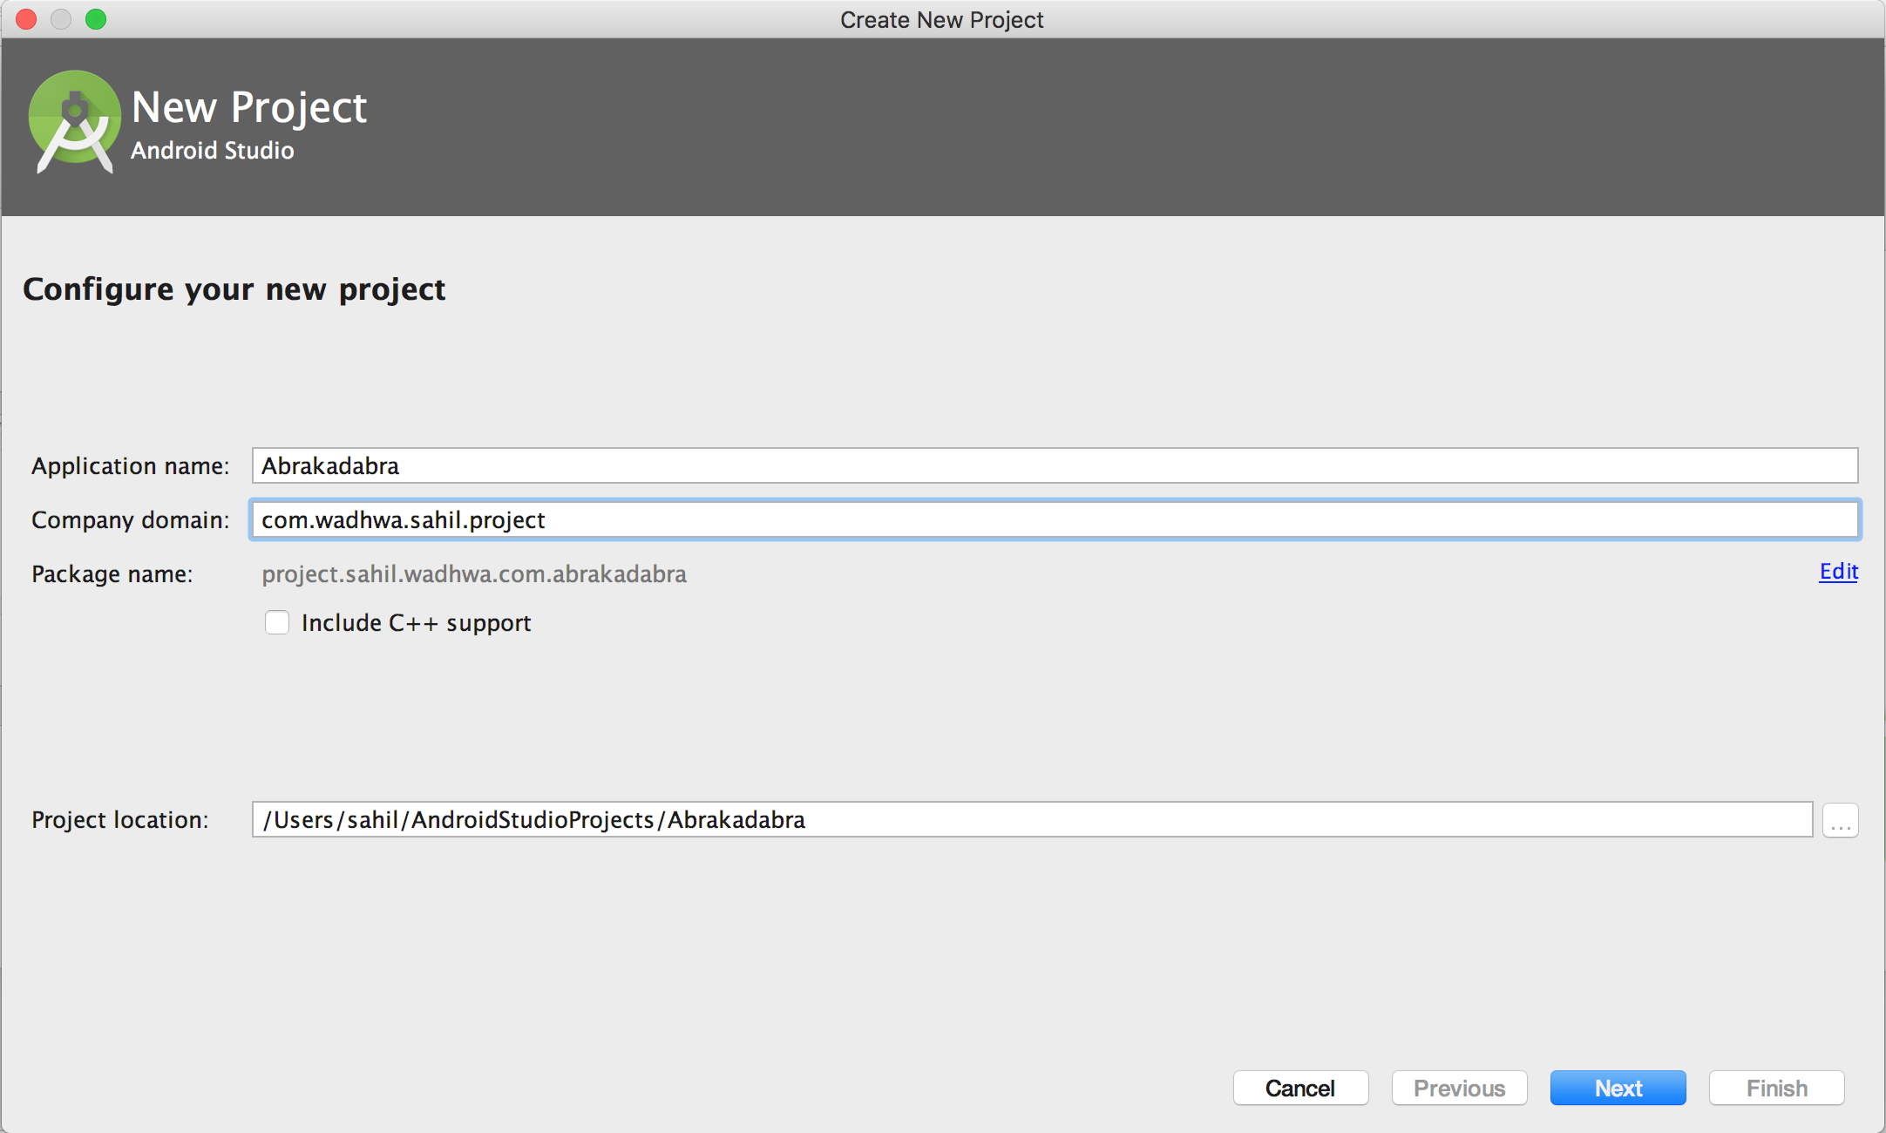
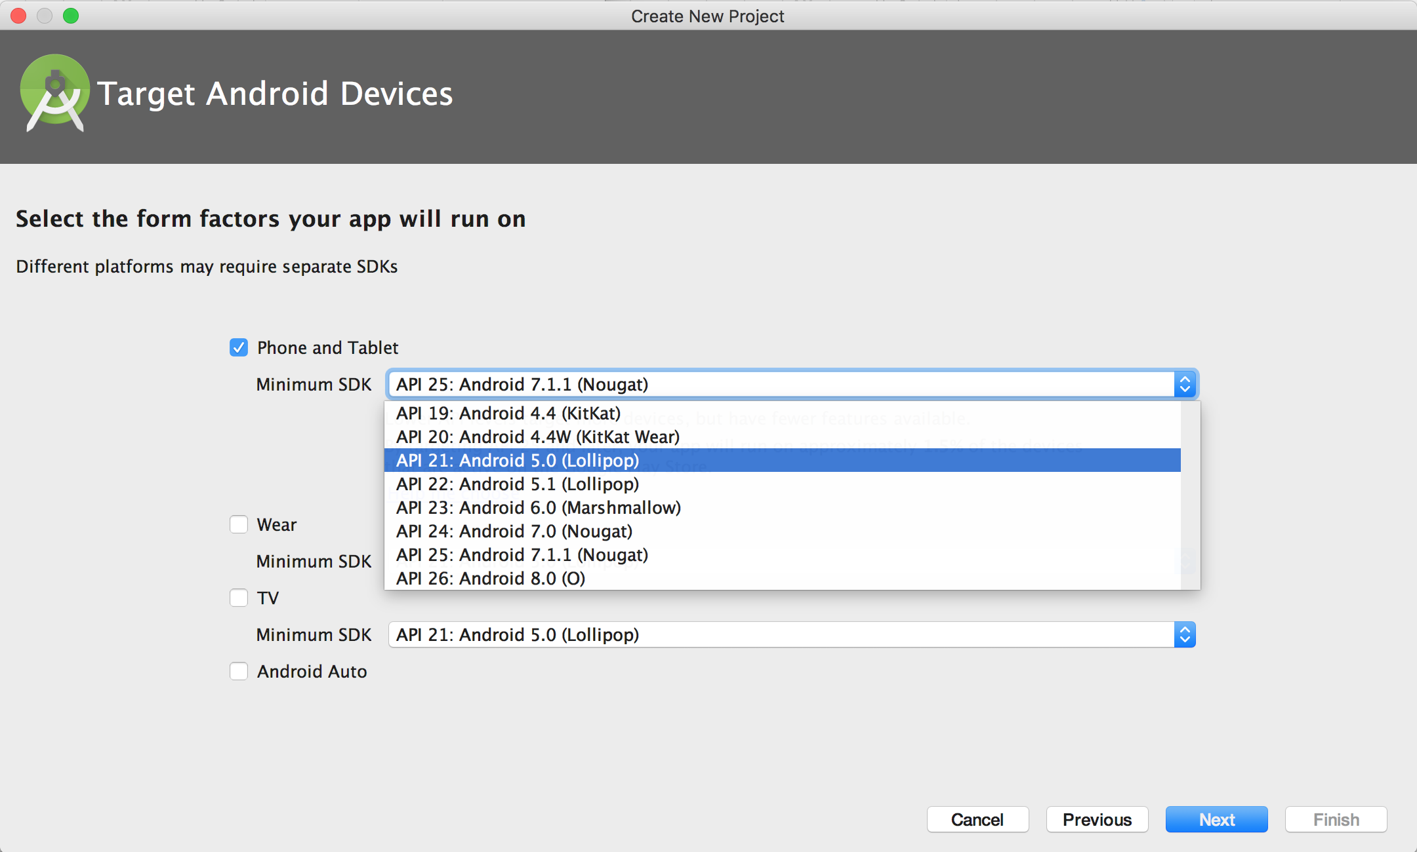
Android Studio - Create a new project
Notes:
For creating a new project, we need to provide application name and an optional company name. If not provided, Android Studio provides a default Company Name.
Project Location can remain as is (under Users/<username>/AndroidStudioProjects/<ProjectName>
While developing for Phones and Tablets, minimum SDK version should be appropriately chosen to have your application backward compatible. API 19, Android 4.4 is a safe option.
You can leave all the other options unchecked.

Slide 17
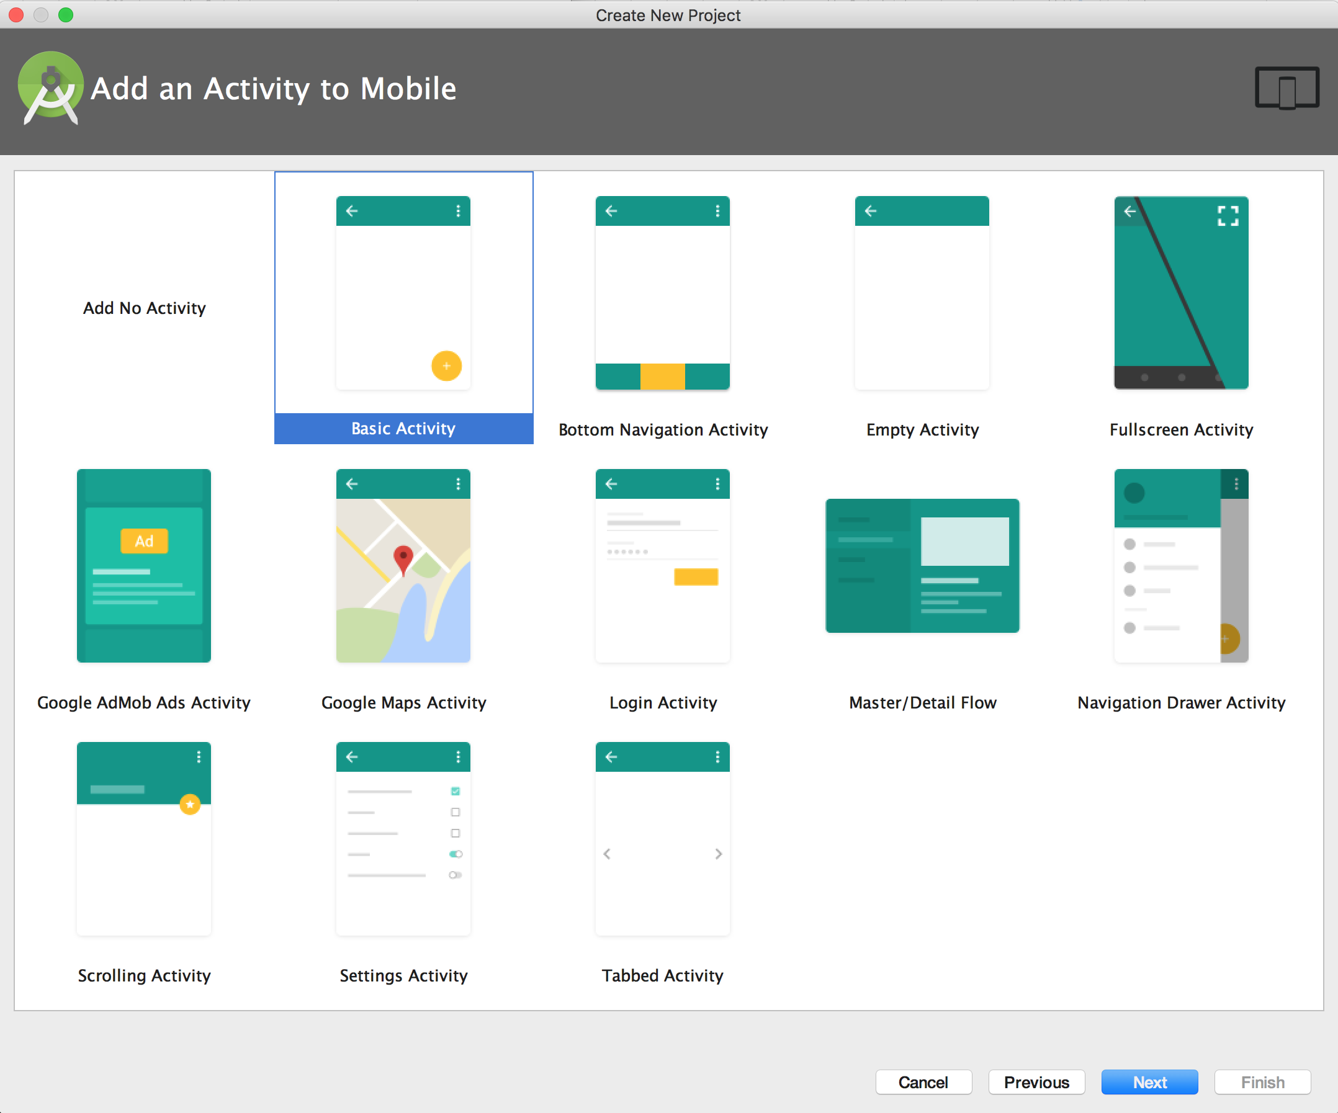
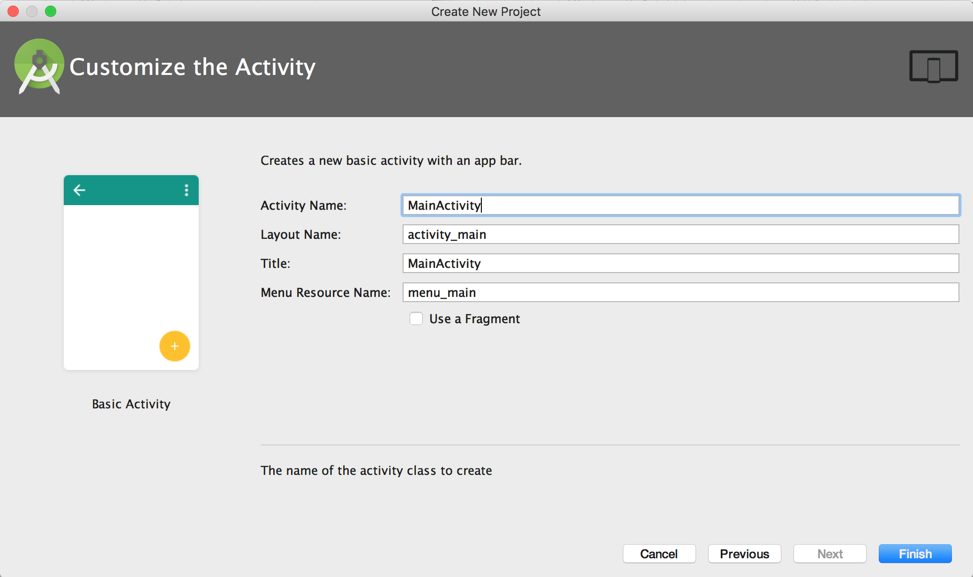
Android Studio - Create a new project (cont’d)
Notes:
You need to select a Basic Activity and click next.
Bottom Navigation Activity- This creates an activity with a navigation bar at the bottom.
Fullscreen Activity- This will create an activity that runs on full-screen.
Google Maps Activity- This will create an activity with Google Maps support.
Login Activity- This will create an Activity with login screen.
Master/Detail View- This will create an Activity with a Master & Detail view. Clicking on each master item will create either a fragment with detail view (in a mobile) or show the detail on the right of master page (in a tablet).
Navigation Drawer Activity- This will create an Activity with a Navigation drawer. Calculator demo uses a Navigation Drawer.
Scrolling Activity- This will create an Activity that can can vertically scrolled.
Tabbed Activity- This will create an Activity with tabs at the top for left and right scrolling.

Slide 18
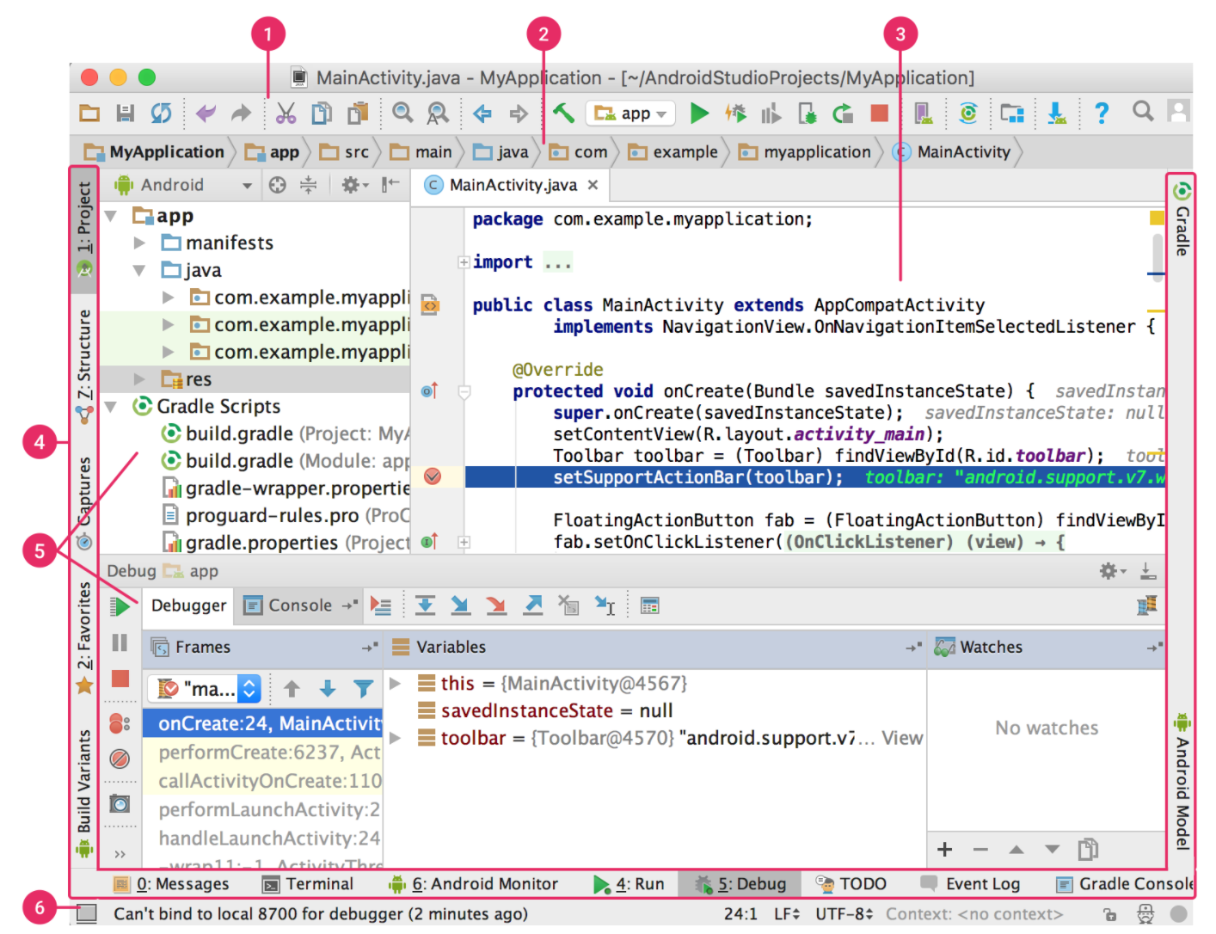
Get familiar with Android Studio
Toolbar
Navigation bar
Editor window
Tool window bar
Tool windows
Status bar
Notes:
The toolbar lets you carry out a wide range of actions, including running your app and launching Android tools.
The navigation bar helps you navigate through your project and open files for editing. It provides a more compact view of the structure visible in the Project window.
The editor window is where you create and modify code. Depending on the current file type, the editor can change. For example, when viewing a layout file, the editor displays the Layout Editor.
The tool window bar runs around the outside of the IDE window and contains the buttons that allow you to expand or collapse individual tool windows.
The tool windows give you access to specific tasks like project management, search, version control, and more. You can expand them and collapse them.
The status bar displays the status of your project and the IDE itself, as well as any warnings or messages.

Slide 19
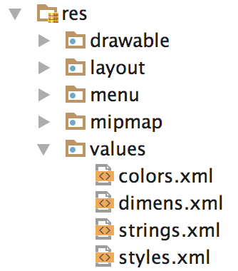
Resources
Types of resources: anim, color, drawable, layout, menu, raw, values, xml.
Alternately, you can create a new directory in res/ named in the form <resources_name>-<config_qualifier>
To access res/drawable/myimage.png and set an ImageView you will use following code −
ImageView imageView = (ImageView)findViewById(R.id.myimageview); imageView.setImageResource(R.drawable.myimage);
Notes:
Here first line of the code make use of R.id.myimageview to get ImageView defined with id myimageview in a Layout file.
Second line of code makes use of R.drawable.myimage to get an image with name myimage available in drawable sub-directory under /res.

Slide 20
Activity
An activity represents a single screen with a user interface.
Android system initiates its program within an Activity starting with a call to onCreate() callback method.
Life-cycle of an Activity:
onCreate(): This is the first callback and called when the activity is first created.
onStart(): This callback is called when the activity becomes visible to the user.
onResume(): This is called when the user starts interacting with the app.
Notes:
Using the Calculator Demo app, if you click on the Activity Navigation item from the left drawer, we can check that first onCreate() is called, followed by onStart() and onResume().

Slide 21
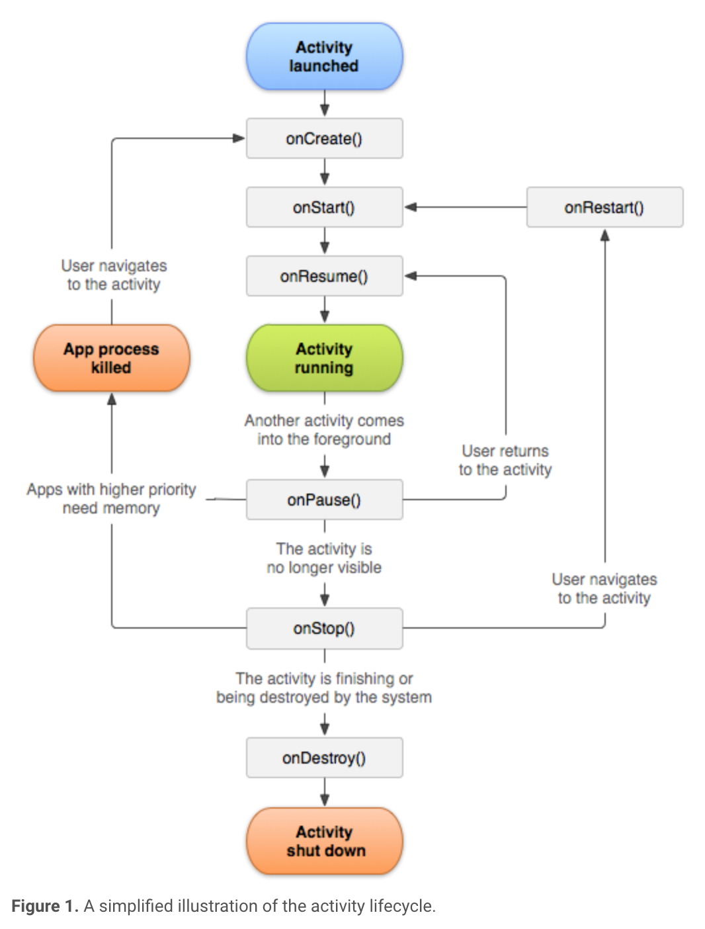
Activity (cont’d)
onPause(): This callback is called when the current activity is being paused and the previous activity is being resumed. During this time, it does not receive user input or execute any code.
onStop(): This callback is called when the activity is no longer visible.
onDestroy(): This callback is called before the activity is destroyed by the system.
onRestart(): This callback is called when the activity restarts after getting stopped.
Notes:
Once you press back on the Calculator demo app from the Activity screen, first of all, onPause() is called, followed by onStop() and onDestroy().
onRestart() will only be called if the Activity is restarted before getting destroyed.

Slide 22
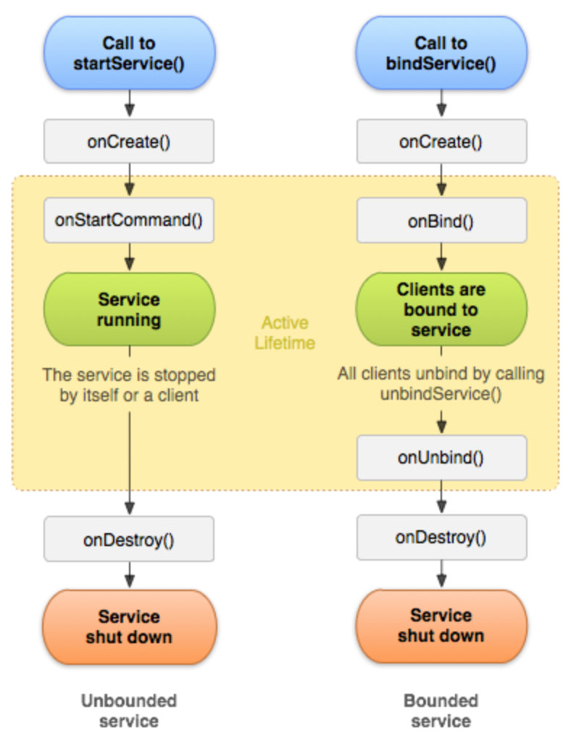
Services
A service runs in the background to perform a task without user interaction and keeps working even if application is destroyed.
A service can essentially take two states −
Started: A service is started when an activity starts it by calling startService().
Bound: A service is bound when an application component binds to it by calling bindService().
Notes:
onStartCommand(): The system invokes this method by calling startService() when another component (such as an activity) requests that the service be started. When this method executes, the service is started and can run in the background indefinitely. If you implement this, it is your responsibility to stop the service when its work is complete by calling stopSelf() or stopService().
onBind()The system invokes this method by calling bindService() when another component wants to bind with the service (such as to perform RPC). In your implementation of this method, you must provide an interface that clients use to communicate with the service by returning an IBinder. You must always implement this method; however, if you don't want to allow binding, you should return null.
onCreate()The system invokes this method to perform one-time setup procedures when the service is initially created (before it calls either onStartCommand() or onBind()). If the service is already running, this method is not called.
onDestroy()The system invokes this method when the service is no longer used and is being destroyed. Your service should implement this to clean up any resources such as threads, registered listeners, or receivers. This is the last call that the service receives.
The Calculator app starts and service and destroys a service. It is shown by a Toast Message.

Slide 23
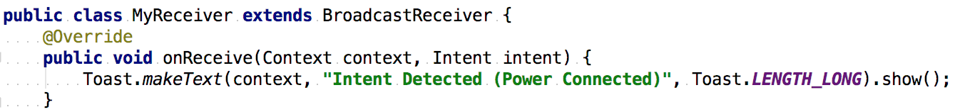
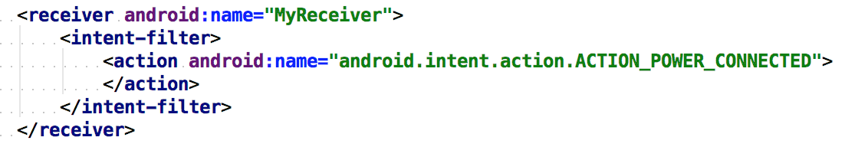
Broadcast Receivers
A Broadcast Receiver reacts to the system generated messages or the messages generated from other applications. These messages are called events or intents.
The following steps are needed to use and respond to events using Broadcast Receiver:
Creating the Broadcast Receiver: A receiver can be created in an Activity by extending the abstract class BroadcastReceiver.
Registering Broadcast Receiver: A receiver can be registered in Android Manifest file.
Notes:
The class implementing it, needs to extend the Broadcast Receiver class. Also, in the Android Manifest file, the class needs to be provided. The intent-filter’s action determines what type of events would be received by the broadcast receiver.
Applications can also initiate broadcasts to let other applications know that some data has been downloaded to the device and is available for them to use, so this is broadcast receiver who will intercept this communication and will initiate appropriate action.
In the Calculator demo app, a broadcasted message is received when the power cable is connected to the device.

Slide 24
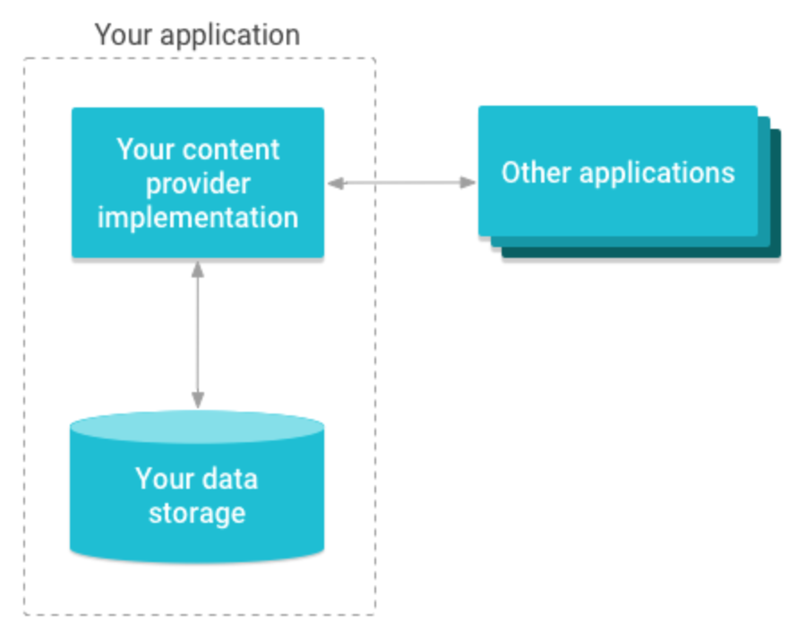
Content Providers
Often data from one application is needed in another application. A content provider supplies data on demand.
Using content providers, you can have centralized data and other applications can access it whenever needed. It behaves more like a database which can be queried, updated, inserted into like any other DB.
Notes:
A content provider can use different ways to store its data and the data can be stored in a database, in files, or even over a network.
In most cases this data is stored in an SQlite database. Other types could be the Internet or files stored on the device.

Slide 25
Fragments
A Fragment is often used for a more modular design- it may or may not be a part of an Activity. It can also be considered as a sub-activity.
A fragment can run without a user interface as well.
A fragment has its own layout and its own behavior with its own life cycle callbacks.
It is possible to dynamically add fragments to a running activity.
A fragment once created, can be used in multiple activities.
A fragment’s life cycle is closely knitted with its parent activity’s life cycle. When the activity is paused or stopped, fragments also replicate the same status.
Usually tablets have multiple fragments running side by side, in one activity (example on next slide)

Slide 26
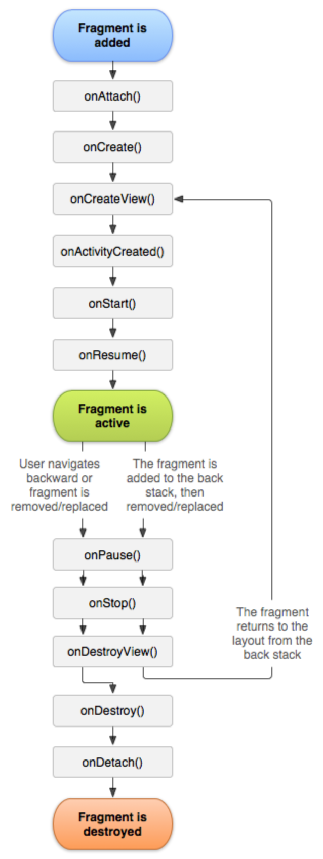
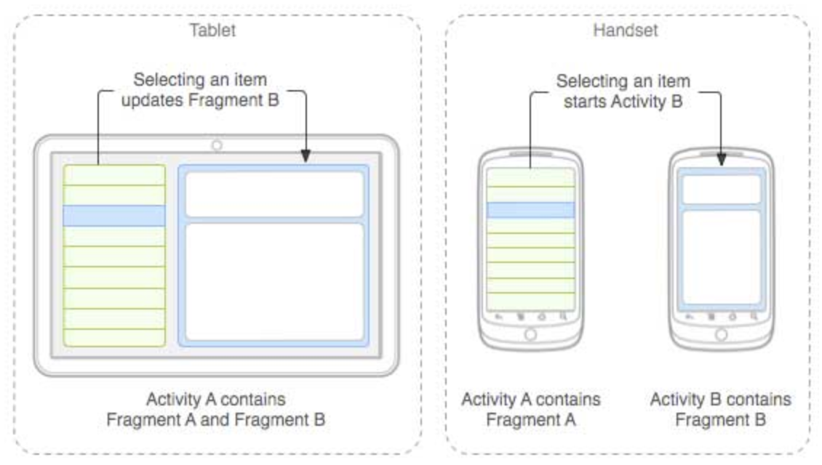
Life cycle of a Fragment
Notes:
Here for a tablet, a single Activity makes use of 2 fragments to communicate with each other.
Whereas in the mobile device, 2 different activities use their own fragments to display same information.
onAttach(): Called when the fragment has been associated with the activity (the Activity is passed in here).
onCreate(): This is the first callback and called when the activity is first created.
onCreateView(): Called to create the view hierarchy associated with the fragment.
onActivityCreated(): Called when the activity's onCreate() method has returned.
onStart(): This callback is called when the activity becomes visible to the user.
onResume(): This is called when the user starts interacting with the app.
onPause(): This callback is called when the current activity is being paused and the previous activity is being resumed. During this time, it does not receive user input or execute any code.
onStop(): This callback is called when the activity is no longer visible.
onDestroyView(): Called when the view hierarchy associated with the fragment is being removed.
onDestroy(): This callback is called before the activity is destroyed by the system.
onDetach(): Called when the fragment is being disassociated from the activity.

Slide 27
Intents & Intent Filters
An Android Intent is a messaging object you can use to request an action from another app component. The 3 main use cases are:
Starting an Activity
Starting a Service
Delivering a broadcast
The primary information contained in an Intent Object is the following:
Component name: The name of the component to start.
Action: A string that specifies the generic action to perform (such as view or pick). This is mandatory part of the Intent object.
Data: The URI (a Uri object) that references the data to be acted on and/or the MIME type of that data.
Notes:
Starting an activity: An Activity represents a single screen in an app. You can start a new instance of an Activity by passing an Intent to startActivity(). The Intent describes the activity to start and carries any necessary data.
If you want to receive a result from the activity when it finishes, call startActivityForResult(). Your activity receives the result as a separate Intent object in your activity's onActivityResult()callback.
Starting a service: A Service is a component that performs operations in the background without a user interface. With Android 5.0 (API level 21) and later, you can start a service with JobScheduler. For versions earlier than Android 5.0 (API level 21), you can start a service by using methods of theService class. You can start a service to perform a one-time operation (such as downloading a file) by passing an Intent to startService(). The Intent describes the service to start and carries any necessary data.
Delivering a broadcast: A broadcast is a message that any app can receive. The system delivers various broadcasts for system events, such as when the system boots up or the device starts charging. You can deliver a broadcast to other apps by passing an Intent to sendBroadcast() or sendOrderedBroadcast()
Component name: The name of the component to start.
Action: A string that specifies the generic action to perform (such as view or pick). This is mandatory part of the Intent object.
Data: The URI (a Uri object) that references the data to be acted on and/or the MIME type of that data.

Slide 28
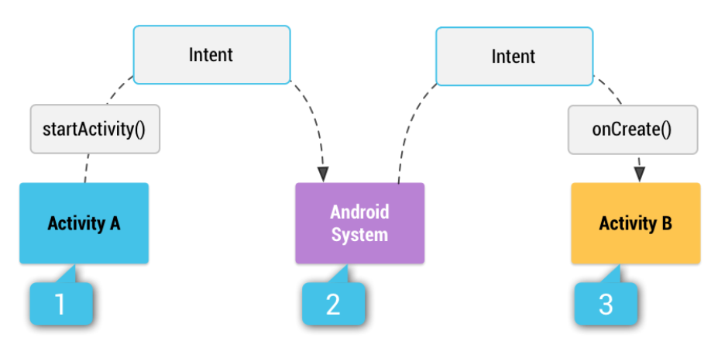
Intents & Intent Filters (cont’d)
Category: A string containing additional information about the kind of component that should handle the intent. The category is an optional part of Intent object.
Extras: This will be in key-value pairs for additional information that should be delivered to the component handling the intent.
Flags: Flags function as metadata for the intent. The flags may instruct the Android system how to launch an activity and how to treat it after it's launched.
Example:
Intent i = new Intent(FirstActivity.this,
SecondActivity.class);
startActivity(i); // Starts SecondActivity
Notes:
Category: A string containing additional information about the kind of component that should handle the intent. The category is an optional part of Intent object.
Extras: This will be in key-value pairs for additional information that should be delivered to the component handling the intent.
Flags: Flags function as metadata for the intent. The flags may instruct the Android system how to launch an activity and how to treat it after it's launched.
The action in an Intent object can be set by the setAction() method and read by getAction().

Slide 29
UI Layouts
A layout, usually defined in XML, describes the structure and placement of UI components for an Activity. You can declare a layout in two ways:
Declare UI elements in XML. Android provides a straightforward XML vocabulary that corresponds to the View classes and subclasses, such as those for widgets and layouts.
Instantiate layout elements at runtime. Your application can create View and ViewGroup objects (and manipulate their properties) programmatically.
Next slide: Example code for defining a TextView and a Button in Linear Layout.
Notes:
View is the base class for widgets, which are used to create interactive UI components like buttons, text fields, etc.
The ViewGroup is a subclass of View and provides invisible container that hold other Views or other ViewGroups and define their layout properties.

Slide 30
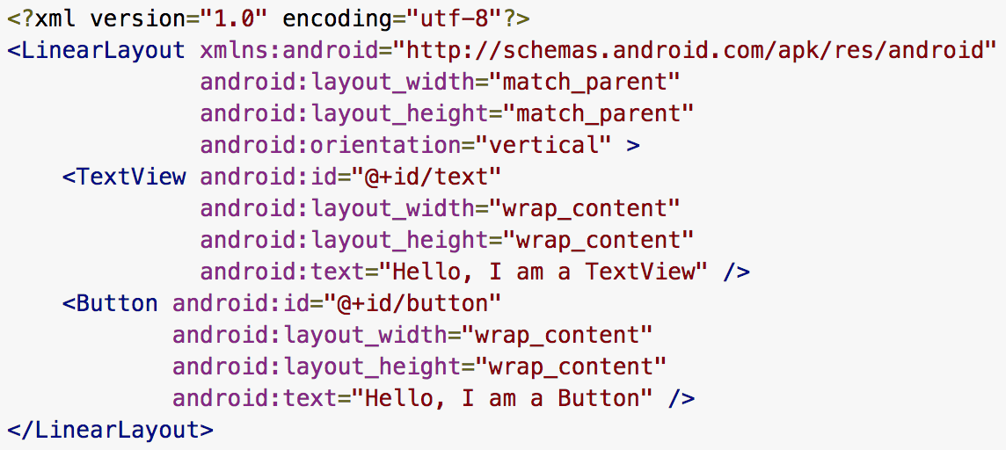
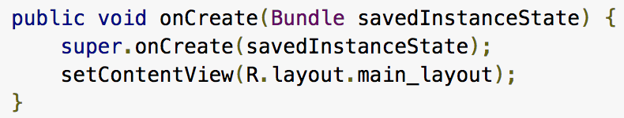
UI Layouts (cont’d)
Loading the XML resource in Java:
Notes:
A linear layout is defined which can hold a TextView and a Button: layout_width is set to match the parent’s so is the height. This means the layout will cover the entire screen. Orientation is vertical.
Textview is defined to show a text field. First component is ID which should be unique across all UI components in a project. Layout width is set to take space only so much as the text length. Height is set to the same text height. Last component is the actual text.
Button is defined with an ID, width and height is set to default length. Also the text of the button is defined.
Process:
Define a view/widget in the layout file and assign it a unique ID
Access it using: Button myButton = (Button) findViewById(R.id.button);
findViewByID() is the method used to link all UI components from XML with the Java code.

Slide 31
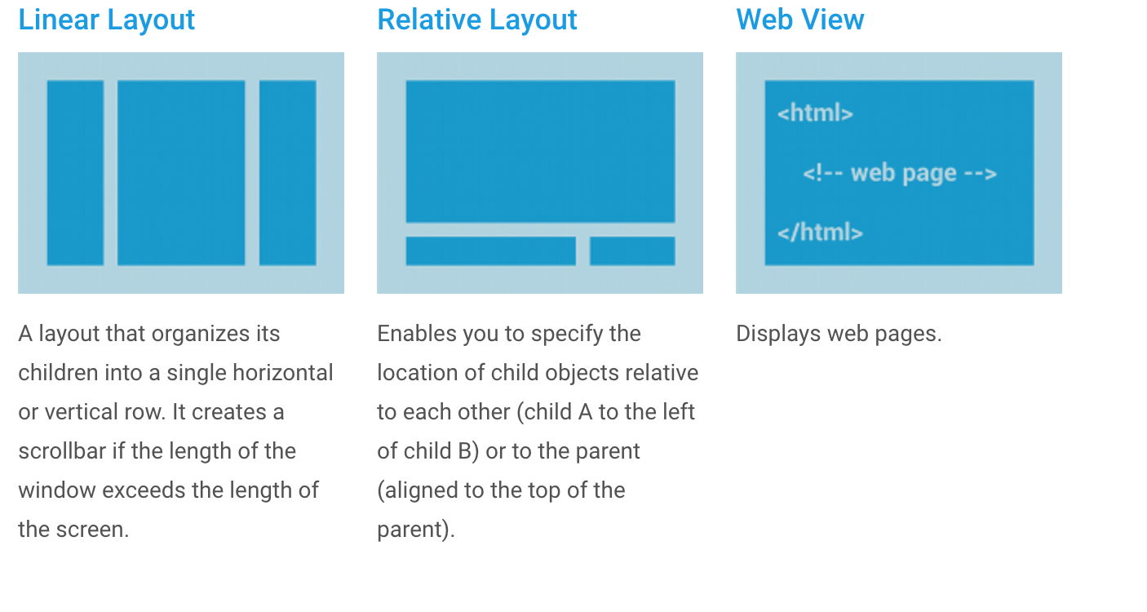
UI Layouts (cont’d)
Common Layouts
Notes:
Other type of UI used is A GridView (which can have rows and columns). A typical example is Caluculator demo app where you can set the number of columns and set the height, padding, margin of each cell so as to make it a proper GridView component. You need to use an Adapter for it. Explained in the later section.

Slide 32
Input Controls
Input Controls controls are the interactive components in your app's user interface. Android provides a wide variety of controls you can use in your UI, such as buttons, text fields, seek bars, check box, zoom buttons, toggle buttons, and many more.
Common controls include:
TextView: This control is used to display text to the user.
EditText: This is a predefined subclass of TextView that includes rich editing capabilities.
Button: A push-button that can be pressed, or clicked, by the user to perform an action.
AutoCompleteView: Similar to EditText, except that it shows a list of completion suggestions automatically while the user is typing.
Notes:
The most common ones are TextView, EditText and Button.
You can set the properties of the UI control either programmatically using the XML editor or by using the Properties pane in the right by clicking on the Design tab at the bottom of the xml file.

Slide 33
Input Controls (cont’d)
ImageButton: This shows a button with an image (instead of text) that can be pressed or clicked by the user.
CheckBox: An on/off switch that can be toggled by the user. You should use check box when presenting users with a group of selectable options that are not mutually exclusive.
RadioButton: The RadioButton has two states: either checked or unchecked.
ProgressBar: The ProgressBar view provides visual feedback about some ongoing tasks, such as when you are performing a task in the background.
Spinner: A drop-down list that allows users to select one value from a set.
TimePicker: The TimePicker view enables users to select a time of the day, in either 24-hour mode or AM/PM mode.
DatePicker: The DatePicker view enables users to select a date of the day.
Notes:
Some components may show up directly on the screen like a Checkbox, Textview, edittext, button, etc.
While some of the components need to be programmatically set to show and hide using Java code example Toast, Spinner, etc.

Slide 34
Event Handling
Events are the way a User interacts with the Android system like button presses or screen touch etc.
The Android framework maintains an event queue as first-in, first-out (FIFO) basis. You can capture these events in your program and take appropriate action as per requirements.
There are three concepts related to Android Event Management.
Event Listeners − An event listener is an interface in the View class that contains a single callback method.
Event Listeners Registration − Event Registration is the process by which an Event Handler gets registered with an Event Listener so that the handler is called when the Event Listener fires the event.
Notes:
Event Listeners − An event listener is an interface in the View class that contains a single callback method. These methods will be called by the Android framework when the View to which the listener has been registered is triggered by user interaction with the item in the UI.

Slide 35
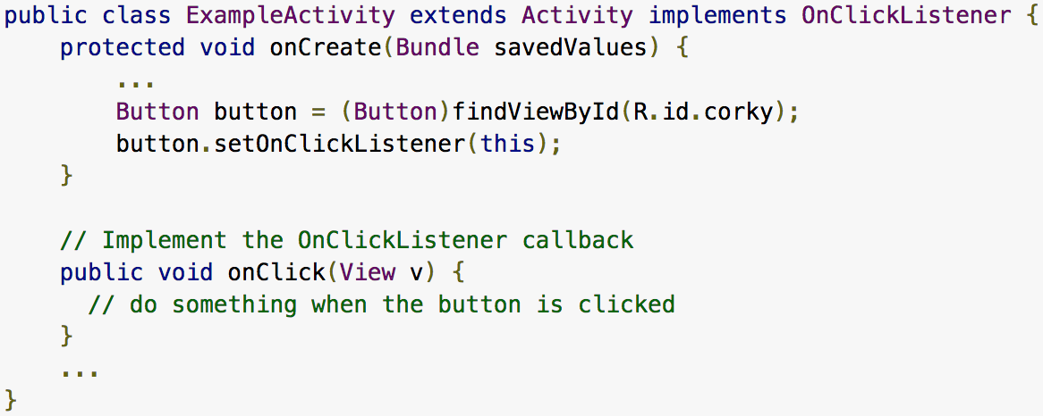
Event Handling (cont’d)
Event Handlers − When an event happens and we have registered an event listener for the event, the event listener calls the Event Handlers, which is the method that actually handles the event.
Two ways of Handling events:
1. Using Event Listeners
Notes:
Here the button named corky is linked from XML with the Java code and then an onClickListener(this) has been added to it so that click events can be handled using the method onClick(View v).

Slide 36
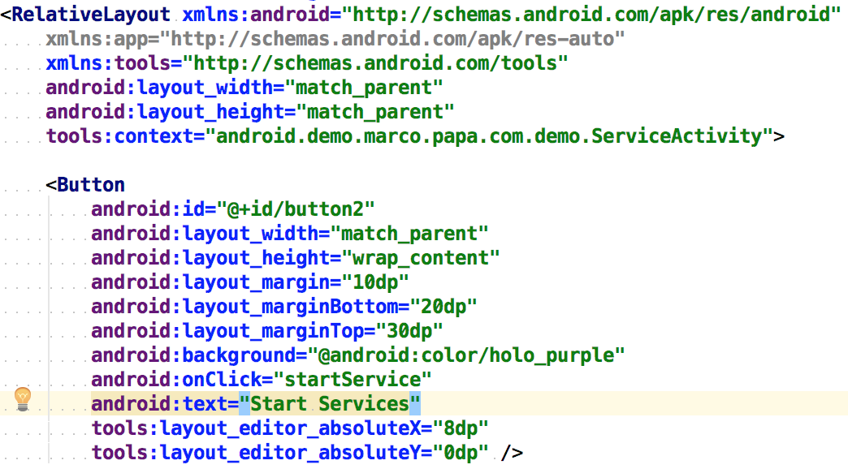
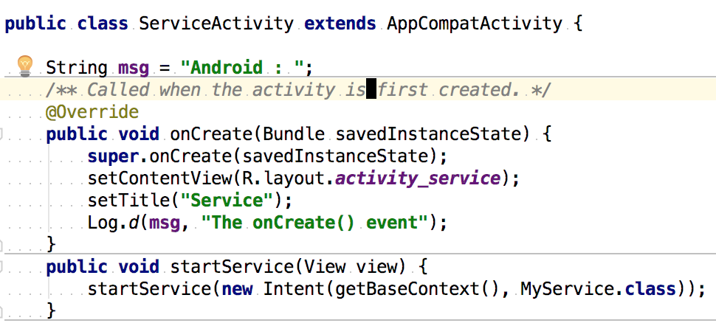
Event Handling (cont’d)
2. Using Event Handler (after declaring method name in the XML)
Notes:
Here, a button is defined in the XML and an onClick() method is defined which is named as Android: onClick= “startService”
This mentions the name of the method that would have to be defined in Java class/Activity to handle the event.
Check startService(View view)

Slide 37
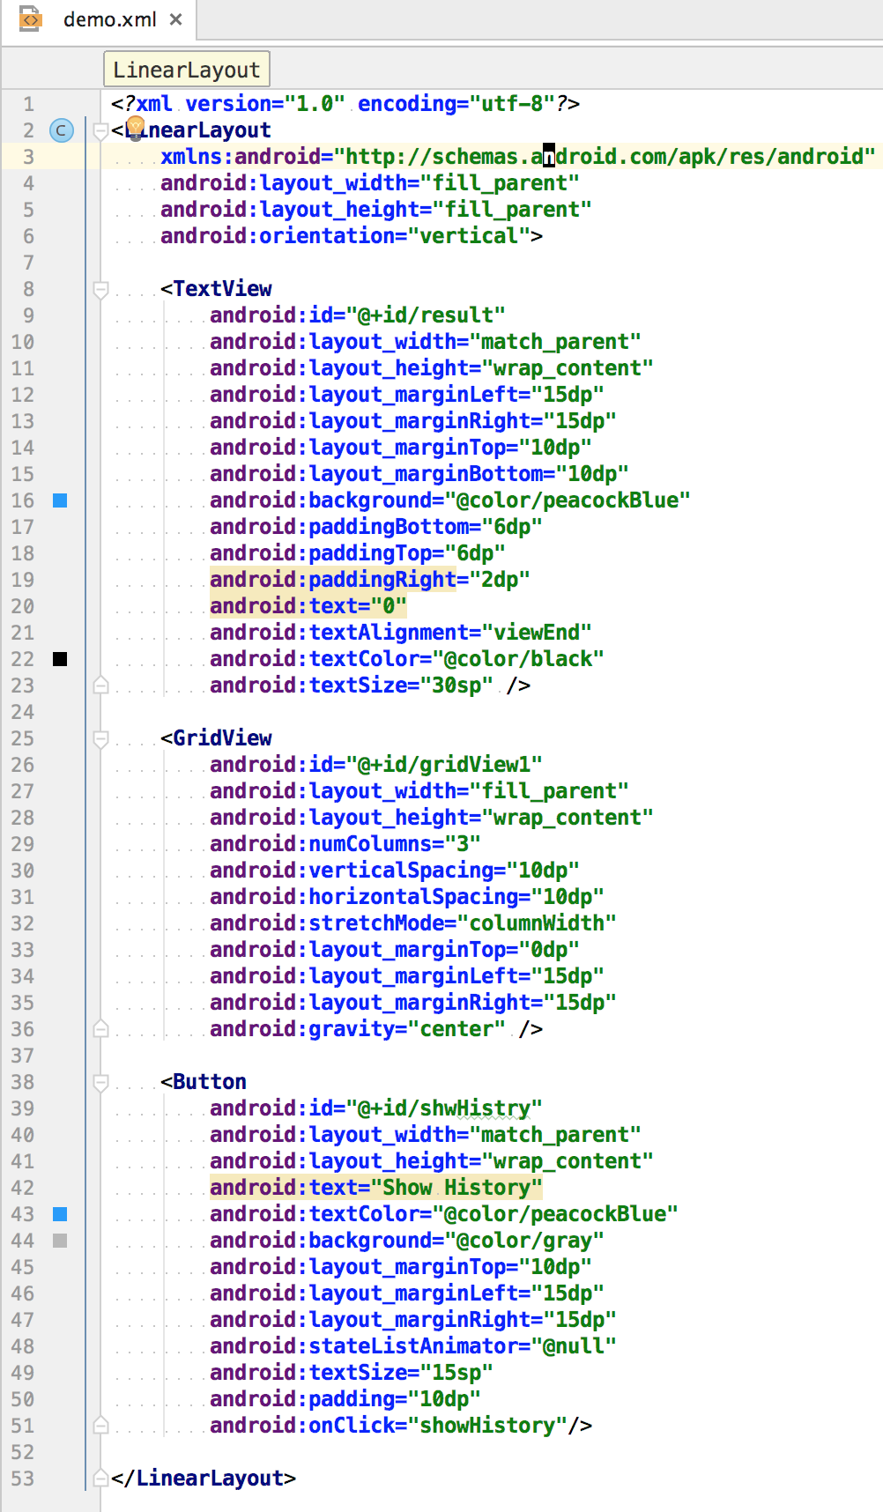
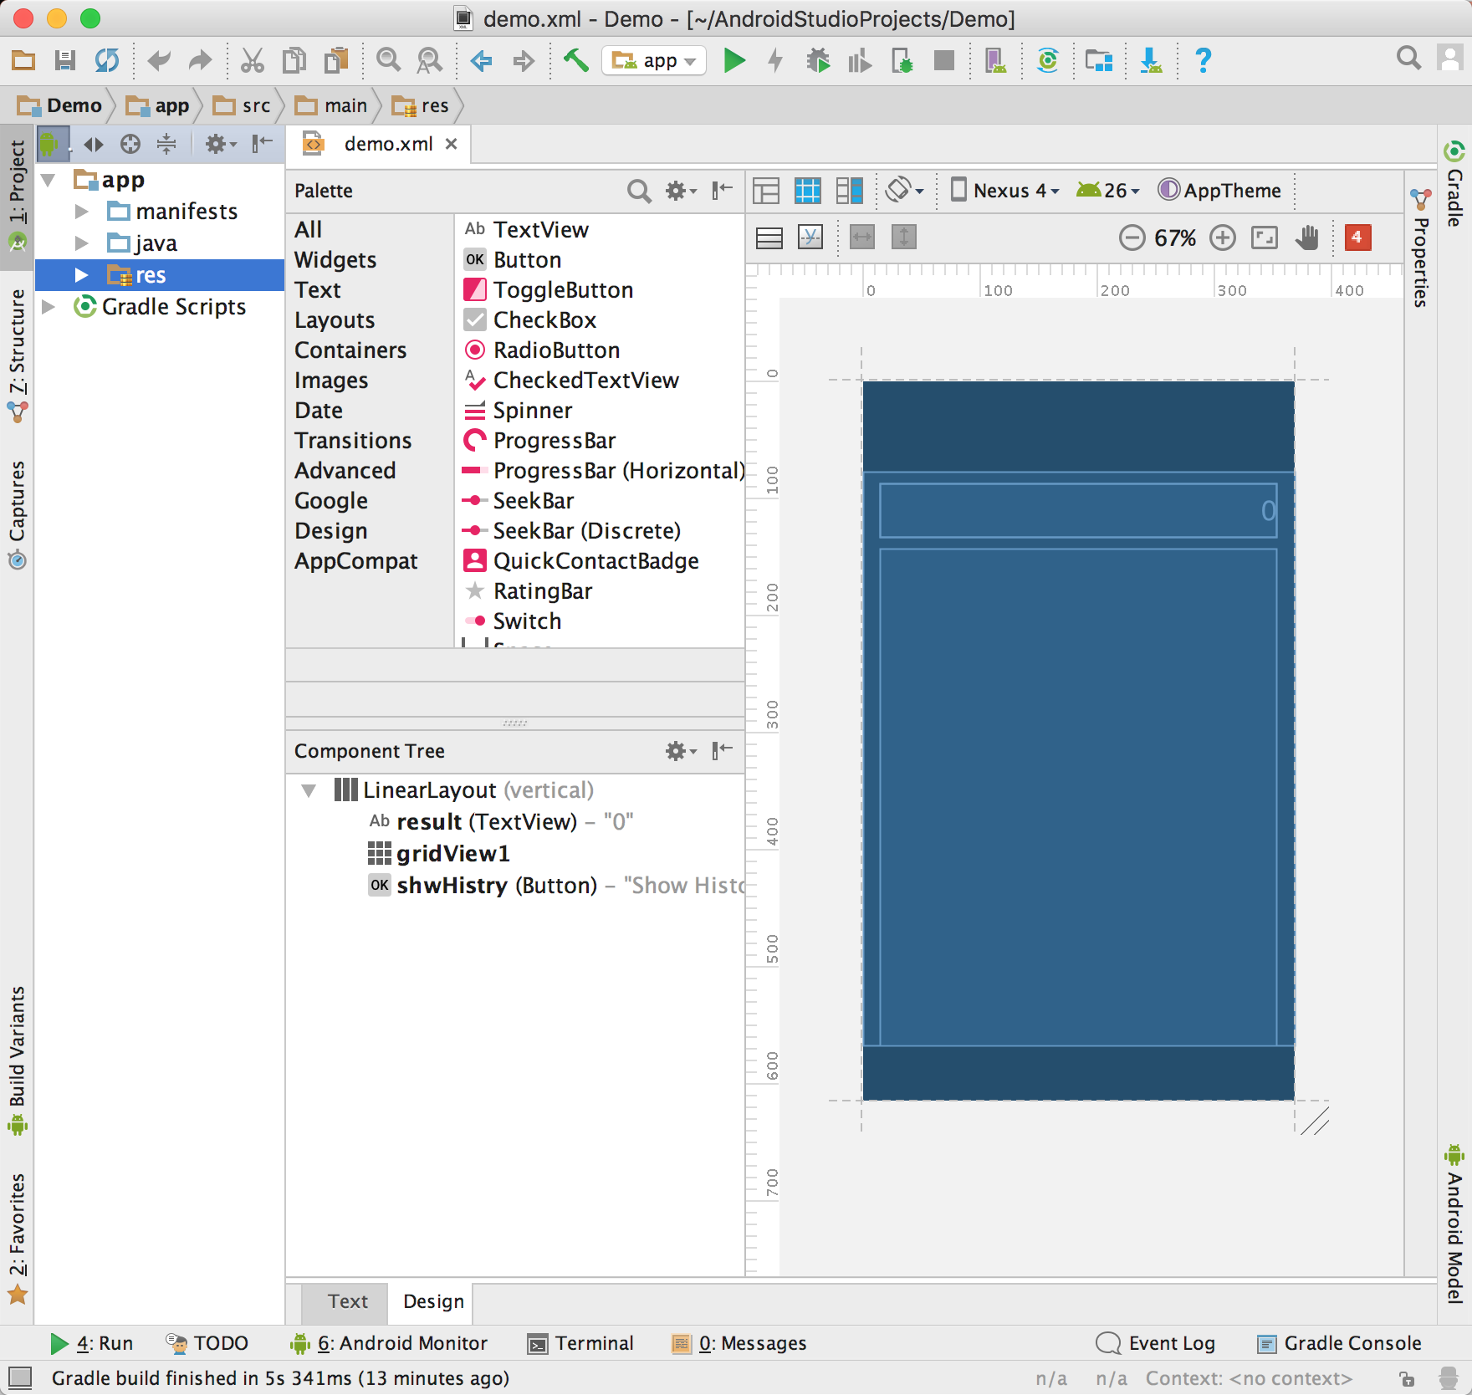
Design UI in XML
Notes:
TextView is defined for the result:
ID has to be unique
Layout width matches parent, ie, full length
Height is default.
Margins are defined on all sides
Background color is defined. Colors are mentioned in values->colors.xml
Padding is defined to have space between text and the top and bottom lines
Default text is set to 0 as a string. Every time this needs to be updated, a text value will be used. TextView accepts only strings.
Textalignment is right
Textcolor is set
Text size is set
GridView is defined to show all the numebrs and + and = signs:
ID is defined
Layout width matches parent, ie, full length
Height is default.
Number of columns is set to 3
Vertical spacing between the grid items is set
Horizontal spacing between the items is set
Margin is defined for all sides
Gravity is defined but is not necessary here
Note: onClick handler is not defined here. Its listener is defined in Java code.
Button is defined to start another activity and show the history:
ID is defined
Layout width matches parent, ie, full length
Height is default.
Default text is shown. This comes from Values->strings.xml
Textcolor is defined
Background color is defined
Margins are defined on all sides
Textsize is defined
Padding is defined
onClick handler is defined for the History button. It’s implementation is there in Java Activity file.

Slide 38
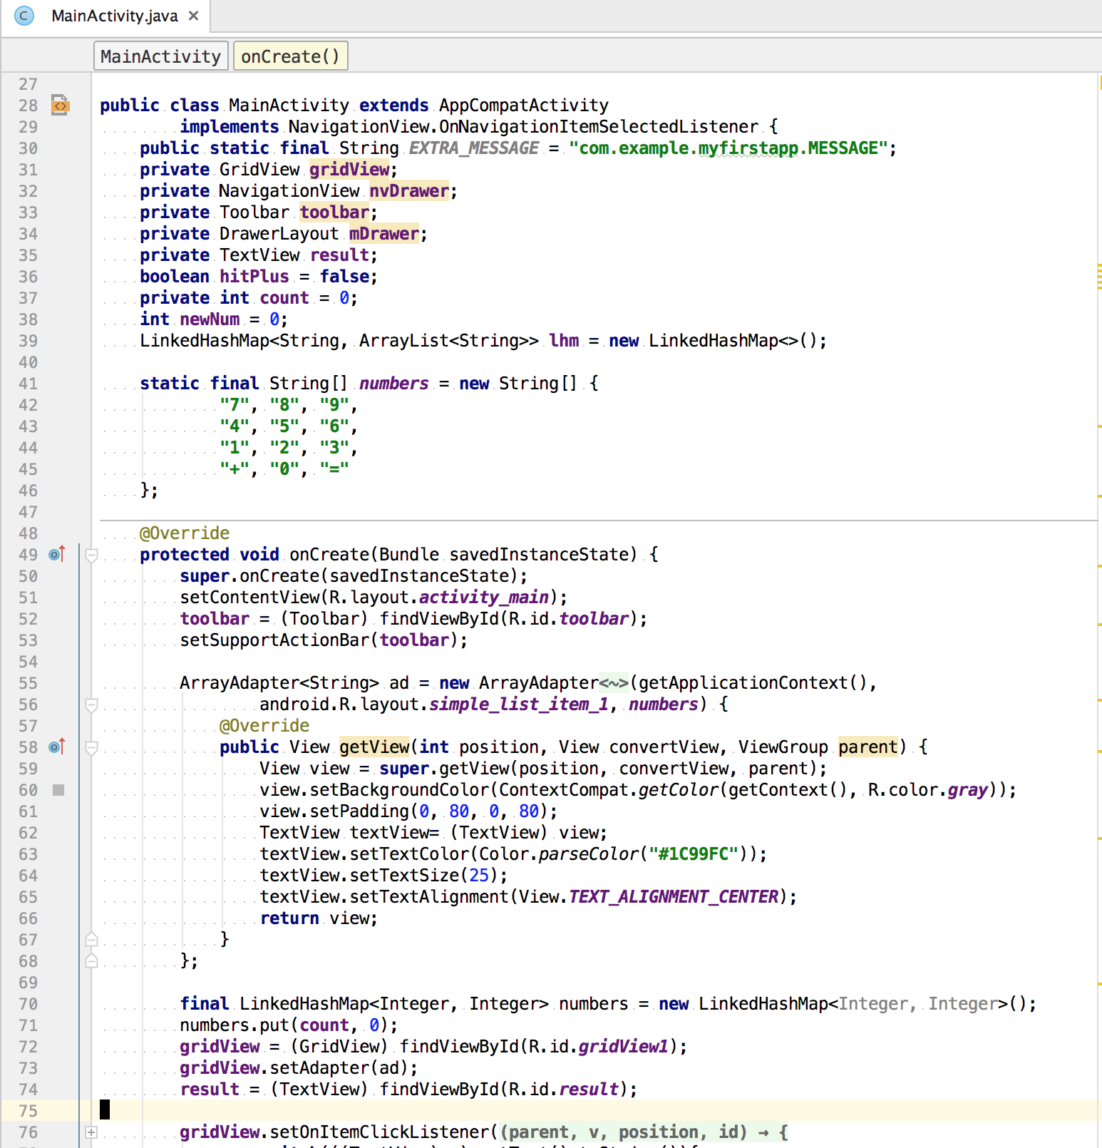
Calculator Demo - Control UI & Logic using Activity
setContentView() sets the first UI - activity_main.xml
Steps to produce a Grid UI:
Define an ArrayAdapter which would contain a list of items.
findViewById(R.id.gridView1) is used to connect UI elements with ID – gridView1 with the Java code.
Set the adapter in the Grid view using the code gridView.setAdapter(ad);
gridView.setOnItemClickListener() is the click listener for the grid items of the calculator.
Notes:
Instantiate GridView by locating its id from XML.
Define an Adapter that contains all the UI elements. This is mostly an Array or ArrayList.
Set the adapter in Grid view using gridView.setAdapter(ad);
Set the onlcicklistener for gridview to act accordingly- update the result bar on the top which is a TextView that has right aligned text.

Slide 39
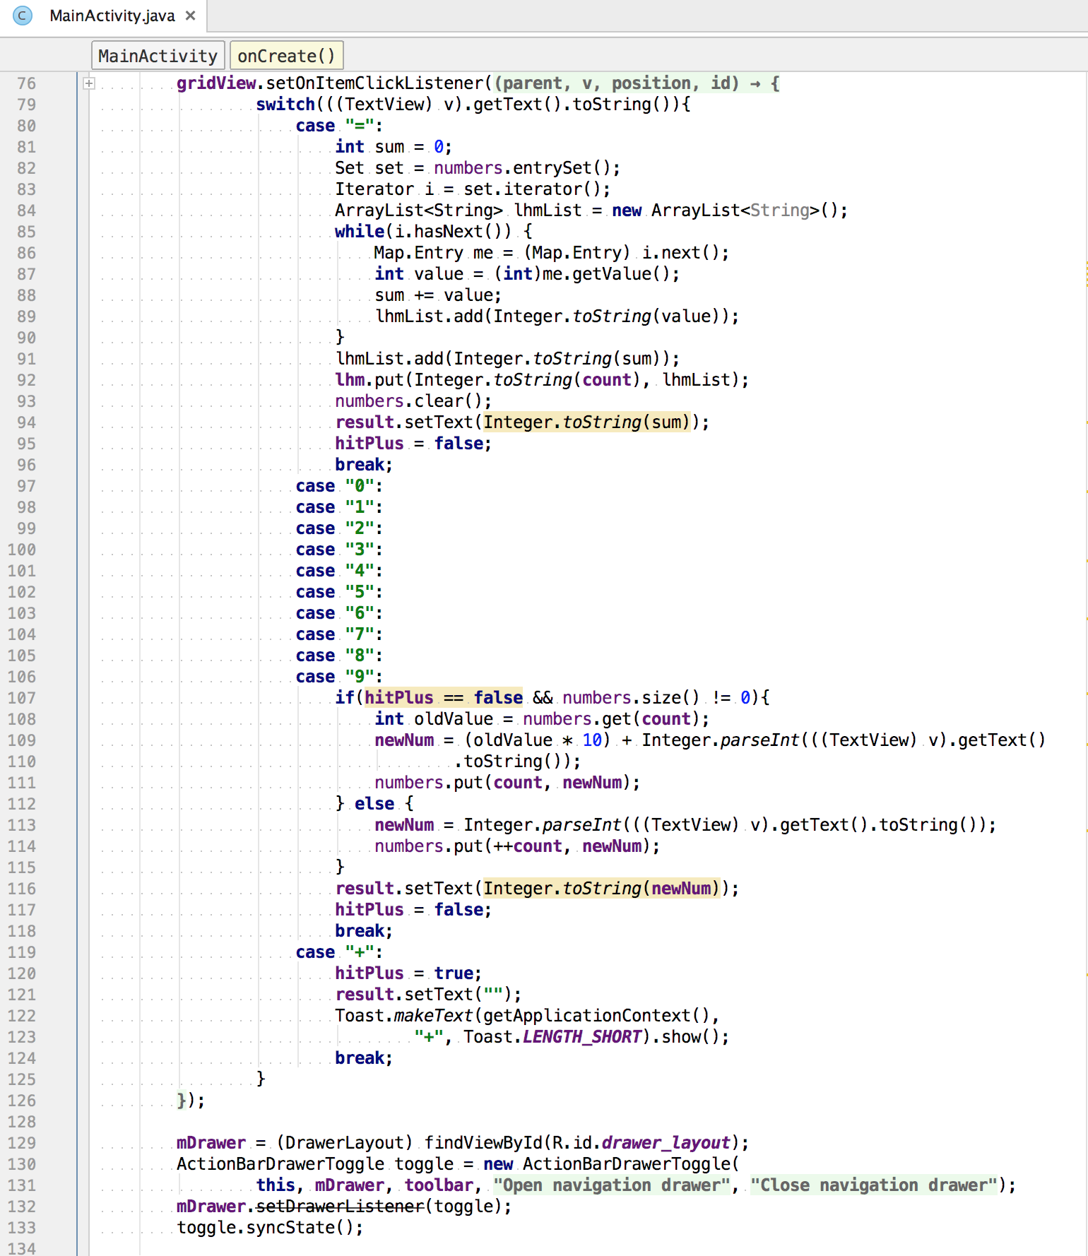
Control UI & Logic using Activity
Logic for Calculator:
While consecutive numbers are pressed, treat them as part of a single number by multiplying the term by 10 every time.
While “+” is clicked, keep updating the UI with the current number.
When “=” is clicked, it marks the end of an addition. Add up all the numbers and display in the result bar.
Add all the queries to a HashMap to display it in the History section.
History is temporary.
Notes:
toolbar = (Toolbar) findViewById(R.id.toolbar); setSupportActionBar(toolbar); // sets the toolbar defined in app_bar_main.XML.
gridView.setOnItemClickListener() listens to all the clicks on grid view items. Depending on whether it is a number, + or an equal to sign, several steps are performed.

Slide 40
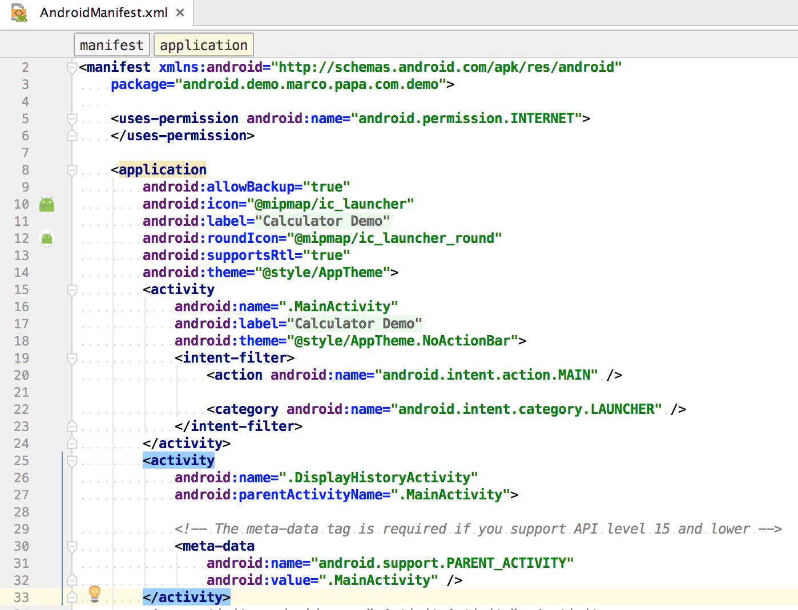
Change Activity properties in Manifest file
Every Activity that is created must be defined in the Manifest file under application tag.
The action for the intent filter indicates that this activity serves as the entry point for the application.
The category for the intent-filter indicates that the application can be launched from the device's launcher icon.
Parent activity can be shown for the up arrow navigation.
Notes:
Attribute android:icon will point to the application icon available under res/drawable-hdpi which is named ic_launcher.png
Attribute android:label Shows the Application name which can be defined in the Strings.xml
The <activity> tag is used to specify an activity and android:name attribute specifies the fully qualified class name of the Activity subclass
android:label attributes specifies a string to use as the label for the activity.
Intent-filer action specifies that this activity is the starting activity for this application.
Intent-filter category as launcher specifies that this application will have an icon to launch the application. There are applications that do not have launcher icon.
You can specify multiple activities using <activity> tags.
For up navigation from second activity, use "parentActivityName" tag.

Slide 41
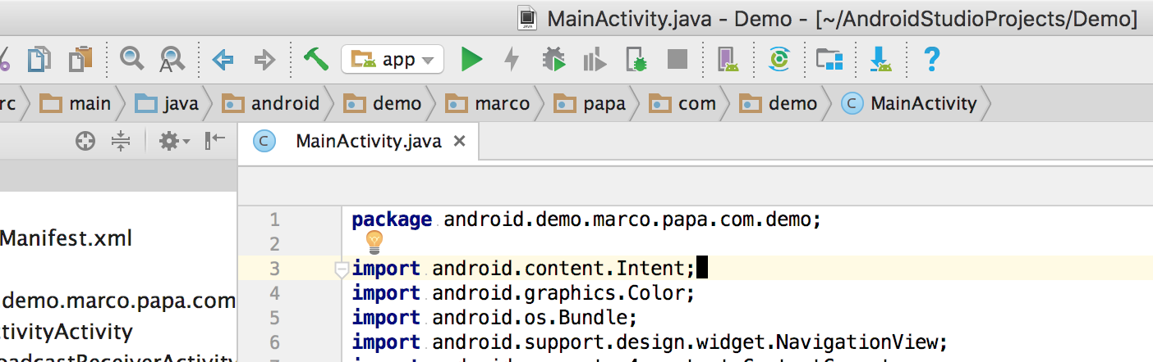
Run your app in the Emulator
To run your app in your own Android device, tap on Build Number from Settings several times. This will enable developer options in your phone. Then enable USB debugging.
To run your app in the Emulator, make sure you have correct SDK & tools installed. Verify using the following steps:
Click on the Project Structure icon and then click on the “app” section under modules.
Under properties, check the Compile SDK Version and Build Tools Version. These should be same.
Under Flavors, Min Sdk Version should be lower than the Compile SDK Version.
Run the app
AVD Manager
Project Structure
SDK Manager
Notes:
You need to follow the exact instructions in order to avoid unnecessary errors.

Slide 42
Run your app in the Emulator (cont’d)
Click on SDK Manager icon and then Appearance & Behavior->Android SDK from the left menu.
Under SDK Platforms, make sure the Compile Android version you selected in the last step is installed.
Under SDK tools, make sure Android Emulator, Android SDK Platform Tools, Android SDK Tools & Intel x86 Emulator Accelerator are all installed.
Click on AVD Manager and then click on Create Virtual Device to fire up a new Emulator.
Under Phone category, click on the profile (mobile type) that you wish to start. Click Next.
Under Recommended section, make sure the Release is already downloaded. If not, download it. Click Next.
Check the AVD Name. That will be the name of the device shown every time you start Emulator. Click Finish.
Now you will see the same device under Your Virtual Devices. Click on the green play button on the right to start the Emulator.
Notes:
You need to follow the exact instructions in order to avoid unnecessary errors.

Slide 43
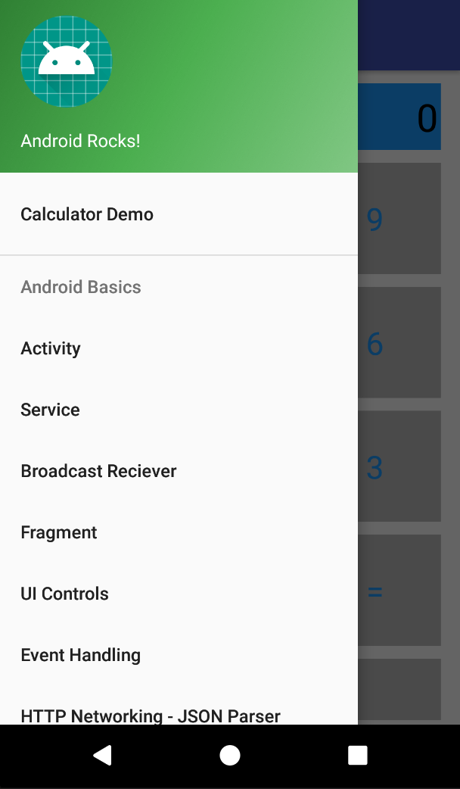
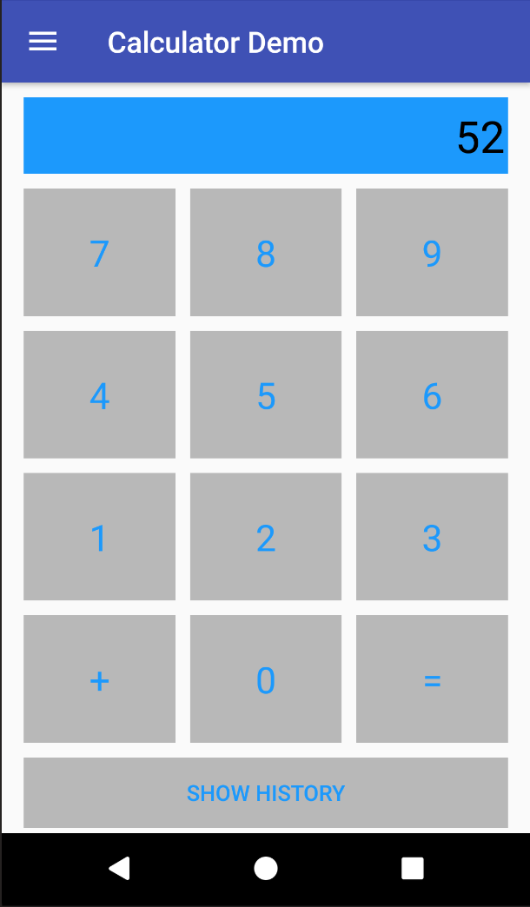
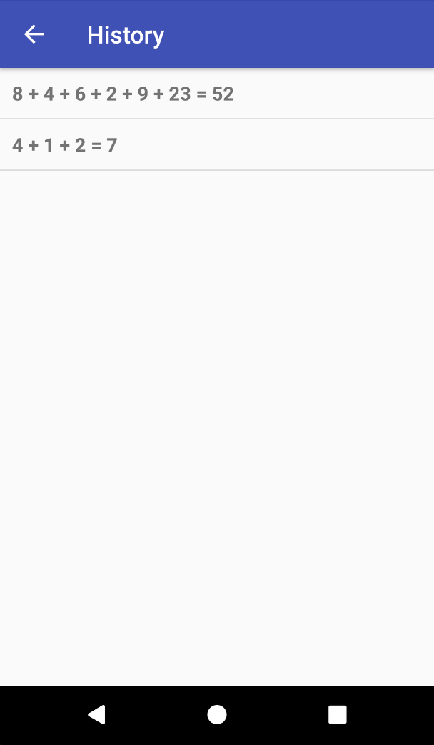
Calculator Demo
Notes:
Click on the Hamburger menu at the top left of the app to open the Navigation panel.
Click on Calculator Demo to start the Calculator demo.
Click on the Show History button at the bottom to start an activity that shows the history of calculations. It might not be in the same sequence though.

Slide 44
Working with 3rd party libraries
There are many times when we need to depend on 3rd party libraries to achieve functionality we want from our app.
Using 3rd party libraries helps save time as we don’t have to reinvent the wheel when somebody else has done it for you. This also saves a lot on debugging time.
We often use Gradle to add the libraries as dependencies to our project (although it is possible to manually download and include the library, but this is not preferred).
Gradle is a flexible tool that allows us to configure how our project is complied, built and packaged into our final app.
Apart from managing dependencies, Gradle is also used to manage different build variants (such as a debug version with logging enabled vs a release version) or project flavors (such as free vs paid versions of the app) or ProGuard configurations (used to shrink app size and obfuscate code to make decompiled code harder to understand).
Notes:
3rd party libraries are often needed to simply tasks. These tasks are often things that many apps will use.
Some examples of such tasks are HTTP requests, loading images etc
Libraries help speed up development of apps by abstracting these tasks into libraries that can be imported into projects that need them
Gradle is used to add libraries as dependencies to our project
https://developer.android.com/studio/build/dependencies.html

Slide 45
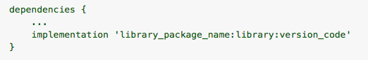
Using Gradle for dependency management
It is fairly simple to add third party libraries to our project via Gradle.
We need to add the following in the build.gradle file for our app module.
We can find the above details on the webpage of the library we want to use.
The build system will automatically find these libraries, download them and include them in your project while building your project. You need not manually download the libraries into your project.
Note: In many examples online you may find ‘compile’ instead of ‘implementation’. Compile was recently deprecated in favor of implementation, but both should work in most cases.
Notes:
Adding dependencies using Gradle: https://developer.android.com/studio/build/dependencies.html

Slide 46
Common 3rd party libraries
In most projects, the following libraries are useful with simplifying common tasks:
Volley
Picasso
Gson
Notes:
Volley – Used for making HTTP requests
Picasso – Used for asynchronously loading images + other features like caching and transforming images
Gson – Used to convert JSON data into Java objects and vice versa. This can be used to directly convert JSON data received from APIs directly into Java objects

Slide 47
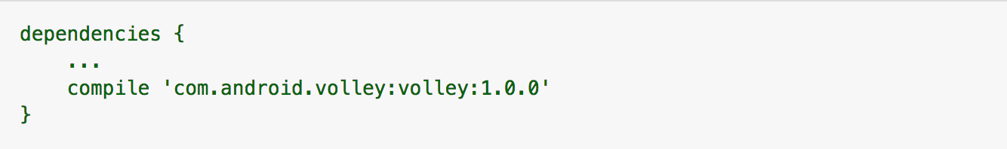
Volley - HTTP Networking and JSON Parsing
Volley is an HTTP library that makes networking for Android apps easier and most importantly, faster. Volley is available on GitHub.
https://github.com/google/volley
Two ways to include Volley in your project:
The easiest way to add Volley to your project is to add the following dependency to your app's build.gradle file:
You can also clone the Volley repository and set it as a library project:
Git clone the repository by typing the following at the command line:
git clone https://github.com/google/volley
Import the downloaded source into your app project as an Android library module.
Notes:
Once you add Volley’s dependency in the app’s build.gradle file, Android Studio will build your project with the new dependencies.

Slide 48
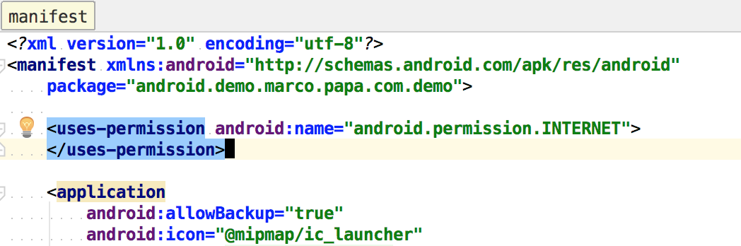
Volley - HTTP Networking and JSON Parsing (cont’d)
To use Volley, you must add the android.permission.INTERNET permission to your app's manifest. Without this, your app won't be able to connect to the network.
Notes:
Volley needs Internet access permission. All permissions are subscribed in the Manifest file.

Slide 49
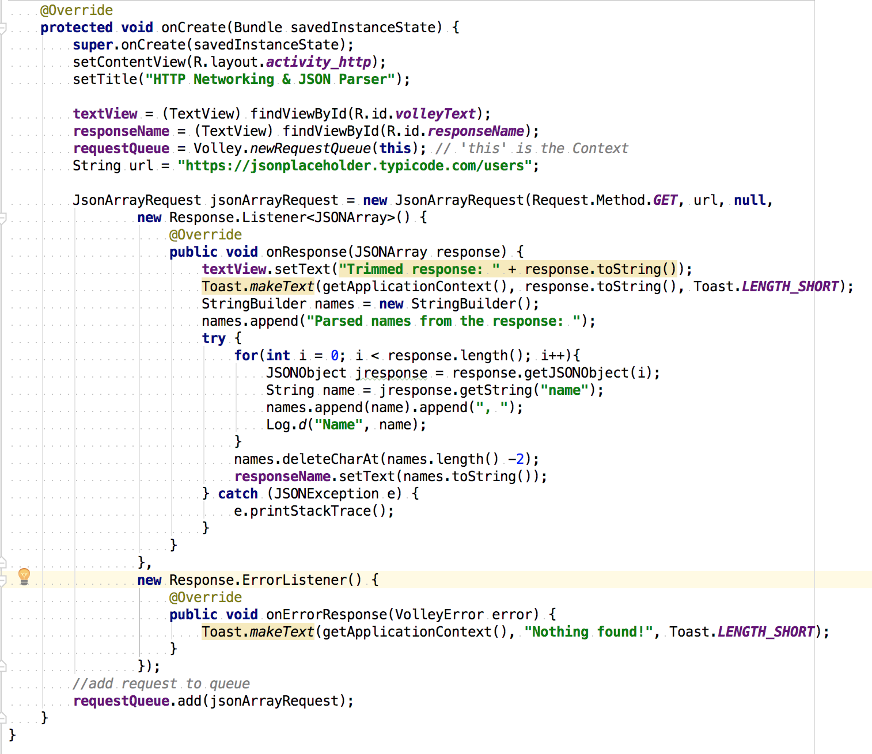
Volley at work
Notes:
how to use the common request types that Volley supports:
StringRequest. Specify a URL and receive a raw string in response. See Setting Up a Request Queue for an example.
JsonObjectRequest and JsonArrayRequest (both subclasses of JsonRequest). Specify a URL and get a JSON object or array (respectively) in response.
Volley provides the following classes for JSON requests:
JsonArrayRequest—A request for retrieving a JSONArray response body at a given URL.
JsonObjectRequest—A request for retrieving a JSONObject response body at a given URL, allowing for an optional JSONObject to be passed in as part of the request body.
Steps:
Instantiate RequestQueue requestQueue = Volley.newRequestQueue(this); // 'this' is the Context
Set the String url.
Instantiate JSONArrayRequest with the call type – GET, url and the response listener.
On receiving a response from the web service, the onResponse() method will be called. Here you can handle the JSONArray response.
Use JSONArrayRequest for getting an Array as a response. JSONObjectResponse will call Response.ErrorListener method.

Slide 50
Picasso – Image downloading and caching
Today’s apps are rich in images that enhance the user interface. But images in apps add many complications.
Images are large in size and take time to download and then render. If we wait for all images to load before showing anything, it can lead to a bad user experience.
Sometimes the user may exit the screen before the image finishes downloading. We need to intelligently cancel the image download in this case.
The same images are often shown multiple times and need to be cached to improve performance.
Often we need to transform our images after downloading (like cropping and resizing).
We also need to handle cases where the image download fails and placeholder images are needed while the actual image loads.
Picasso has simple functions to take care of this, so that we focus on developing our app.
Notes:
Handles various tedious to implement features like: asynchronously loading images, caching and image transformations
http://square.github.io/picasso/

Slide 51
Picasso – Image downloading and caching
We can easily add Picasso to our project using Gradle. implementation 'com.squareup.picasso:picasso:2.71828'
We can then import the Picasso class into the .java file where we wish to Picasso to load images. import com.squareup.picasso.Picasso;
For most cases, this one line of code is all we need to load our image: Picasso.with(context).load("http://ourdomainname/image.png") .into(imageView); This takes care of asynchronously downloading the image, caching and auto-canceling download when no longer needed.
Notes:
Picasso.with(context).load("http://ourdomainname/image.png").into(imageView);
Context: current application context
imageView: ImageView object into which the image is to be loaded

Slide 52
Picasso – Image downloading and caching
Simple methods also exist to resize, rotate and crop the image. Picasso.with(context).load("http://ourdomainname/image.png") .resize(width, height) .rotate(degrees) .centerCrop() .into(imageView);
Picasso also provides methods for placeholder images while our image loads and for the case where our image download failed. Picasso.with(context).load("http://ourdomainname/image.png") .placeholder(R.drawable.placeholder_image) .error(R.drawable.error_image) .into(imageView);
Notes:
Picasso.with(context).load("http://ourdomainname/image.png").resize(width,height).rotate(degrees).centerCrop().into(imageView);
Context: current application context
Width: width in pixels
Height: height in pixels
Degrees: angles in degrees
imageView: ImageView object into which the image is to be loaded
Picasso.with(context).load("http://ourdomainname/image.png").placeholder(R.drawable.placeholder_image).error(R.drawable.error_image).into(imageView);
R.drawable.placeholder_image: drawable resource for placeholder image
R.drawable.error_image: drawable resource for error image

Slide 53
Gson – serializing and desterilizing Java objects
Gson is a library that is used to convert Java objects into their JSON representation and vice-versa.
With this you can easily convert your Java objects to their JSON string representations. This is very useful when you need to send data between activities or when you need to store an object for it to persist the next time you use the app.
Another use case is for communicating with APIs that send/receive JSON data.
This saves us from writing code to parse our JSON into Java objects and vice versa. We only need to define the model of the data that we expect to receive and the library will take care of the parsing.
Notes:
Gson is a popular library for concerting JSON data into Java objects and vice versa.
Useful to directly convert API responses into Java objects
https://github.com/google/gson

Slide 54
Gson – serializing and desterilizing Java objects
We can easily add Gson to our project using Gradle. implementation 'com.google.code.gson:gson:2.8.2'
Lets assume we get this JSON object from our API: [ { "name": "John Doe", "email_id": john@doe.com }, { "name": "Jane Doe", "email_id": jane@doe.com } ]

Slide 55
Gson – serializing and desterilizing Java objects
Lets use the following class to store data received from our API: //this class defines the model of our JSON data public class Contact { //we can use the same name as the field in the JSON object //no special annotation is needed in this case String name; //We can also use our names using the //@SerializedName annotation @SerializedName(“email_id”) //name of field in JSON object String emailID; //our object name }

Slide 56
Gson – serializing and desterilizing Java objects
In our onResponse() method for our Volley HTTP request, we can directly parse the response into an array of Java objects JsonObjectRequest jsonObjectRequest = new JsonObjectRequest(Request.Method.GET, url, null, new Response.Listener<String>() { @Override public void onResponse(String response) { Contact[] contacts = (Contacts[]) gson.fromJson(response, Contact[].class); } }, new Response.ErrorListener() { @Override public void onErrorResponse(VolleyError error) { //... } });
Like so, we have directly parsed our JSON response.

Slide 57
References
https://developer.android.com/studio/intro/index.html
https://www.tutorialspoint.com/android
https://www.javatpoint.com/android-tutorial
http://socialcompare.com/en/comparison/android-versions-comparison
http://square.github.io/picasso/
https://github.com/google/gson
https://kylewbanks.com/blog/tutorial-parsing-json-on-android-using-gson-and-volley

